Slide 1

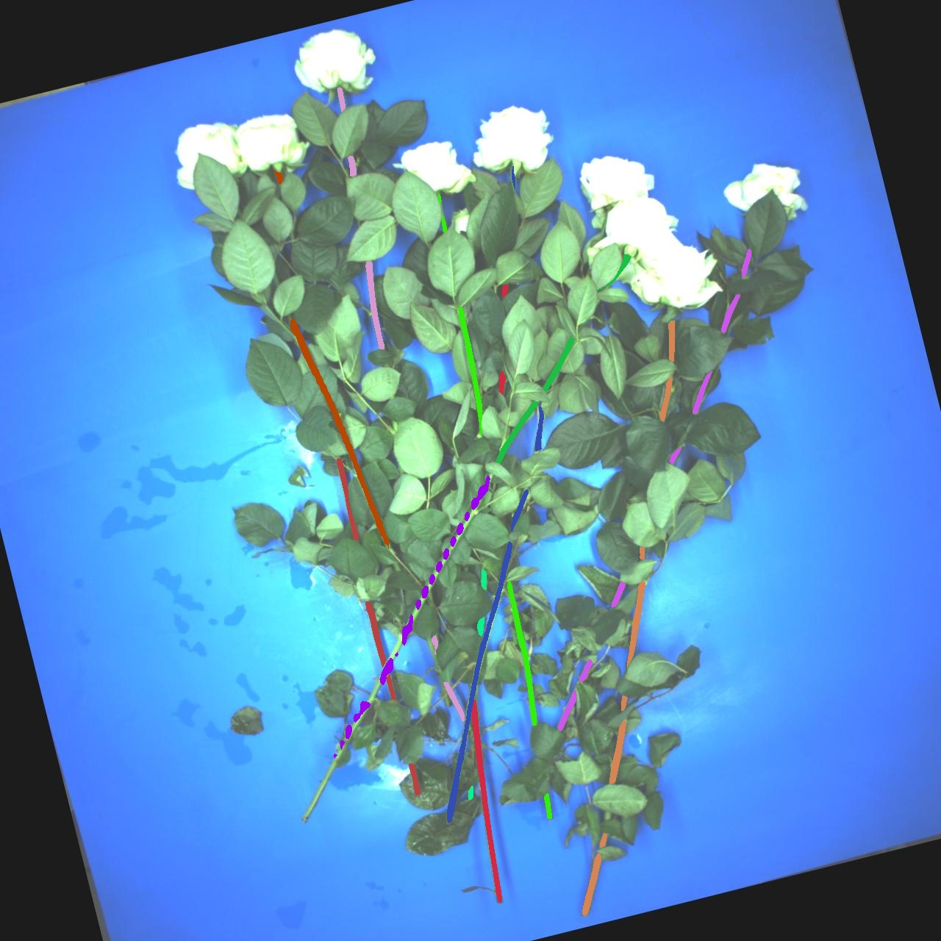
Correction on Stem Pairing
Week 7 Hua Jiang

Slide 2
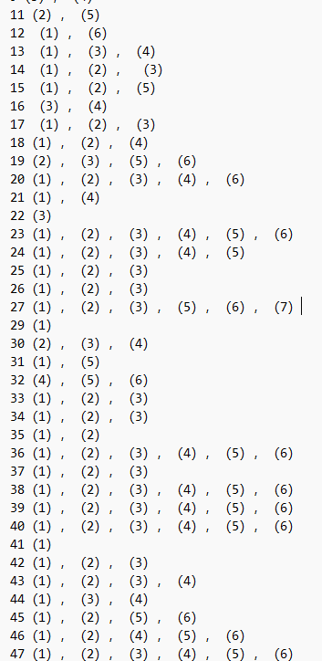
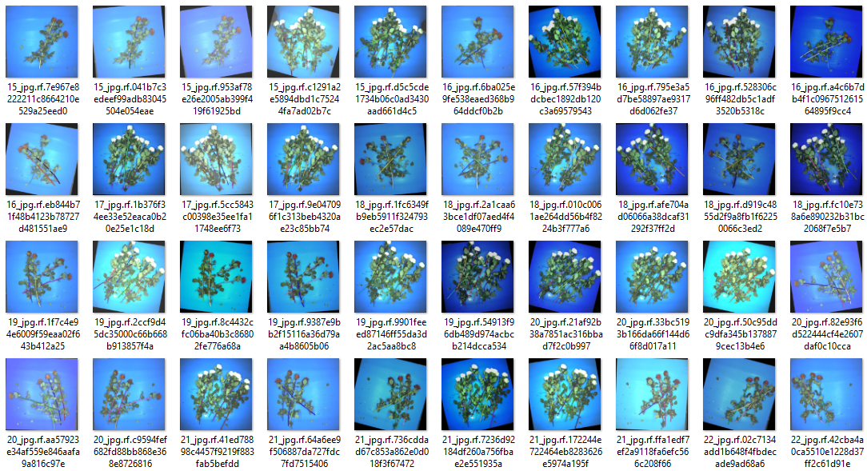
50 images with various data augmentation,
tons of errors

Slide 3
1. Incorrect length measuring
2. Center problem in Scoring
3. Inaccurate PCA direction computing
4. Same as 2
3
2
1
4

Slide 4

Incorrect length measuring:
Due to the defect of mask-rcnn, sometimes the long stem mask can be disconnected and sparse which leads to the unsymmetrical center .
By calculating the center from PCA and the length with
‘center + length/2’, we estimate the wrong stem position
Longer than its actual length
The neighbor stem is filtered out

Slide 5

Incorrect length measuring:
Instead of ‘center + length/2’, I divide the length into up_length and low_length to solve the unsymmetrical problem.
up_length
low_length

Slide 6

Incorrect length measuring:
Instead of ‘center + length/2’, I divide the length into up_length and low_length to solve the unsymmetrical problem.

Slide 7
2. Center problem in Scoring
Base stem
Actual neighbor
If the center of the stem is too close to the base vector, the score approches 0
This stem estimated with lower score than the actual neighbor

Slide 8
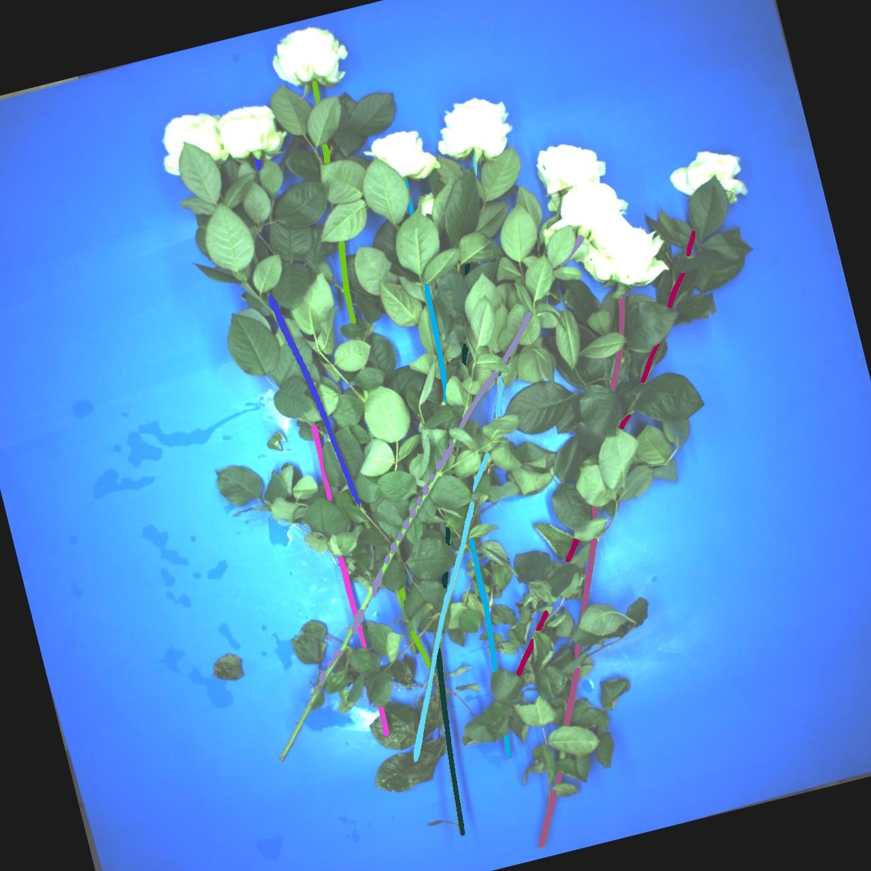
2. Center problem in Scoring
radius = abs(np.linalg.norm(inter - c2) - (l2[0]+l2[1])/2)
Base stem
Actual neighbor
If the center of the stem is too close to the base vector, the score approches 0

Slide 9
4. Center problem in Scoring
radius = abs(np.linalg.norm(inter - c2) - (l2[0]+l2[1])/2)
Base stem
This stem estimated with lower score than the actual neighbor
Now we put this 0, when the top is too close to the base vector
Actual neighbor

Slide 10
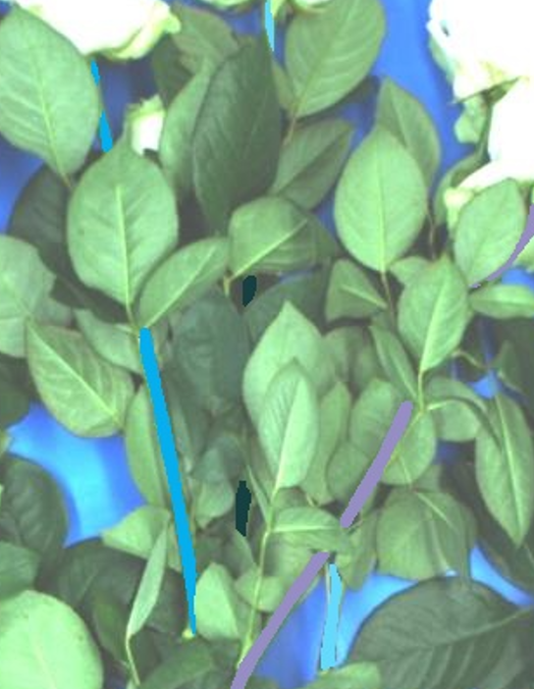
Base stem
3. Inaccurate PCA direction computing
PCA direction of rhombus or long rectangle is the diagonal instead of the central axis
Actual neighbor
Wrong connection

Slide 11
Future Work:
Improve Stem Pairing Algorithm

